Slide 1

Flows
WSO2 Identity Server Fundamentals

Slide 2
The problem
Static flows restrict user journeys to predefined configurations.
Customizations are rigid, making it difficult to adapt to evolving user and business requirements.
Administrators lack centralized control to design, compose, and manage advanced user journeys.

Slide 3
What are Flows?
Flows enable the design of custom, step-by-step user journeys.

Slide 4
What Flows can you build?
When a user self-registers to your organization.
When a user recovers a password.
When users created by an administrator, set their own passwords.

Slide 5
An example use case
I want to design a two step Flow when users self-register to my application. I need all users to have a verified mobile number.
Step 1: Users register using a form, or choose Sign in with Google.
Step 2:
  Users verify their mobile number using an OTP.
  If the user signs in with Google, they provide a mobile number before OTP verification.

Slide 6
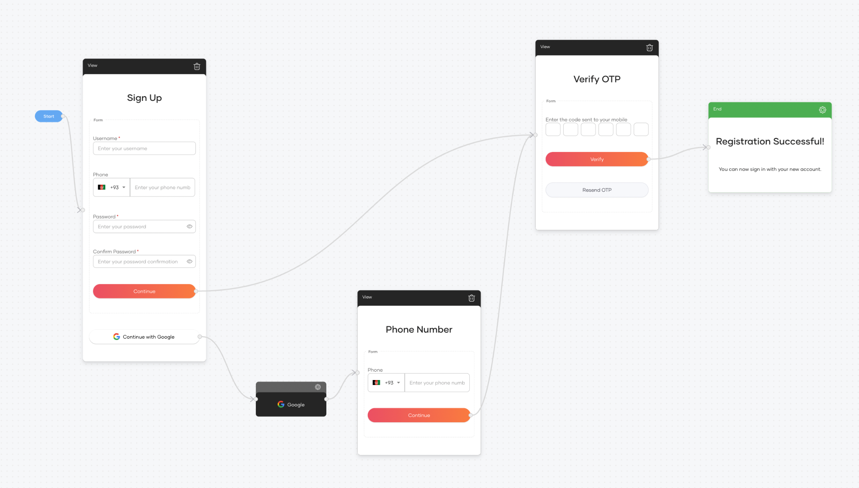
An example use case

Slide 7
Flow Elements

Slide 8
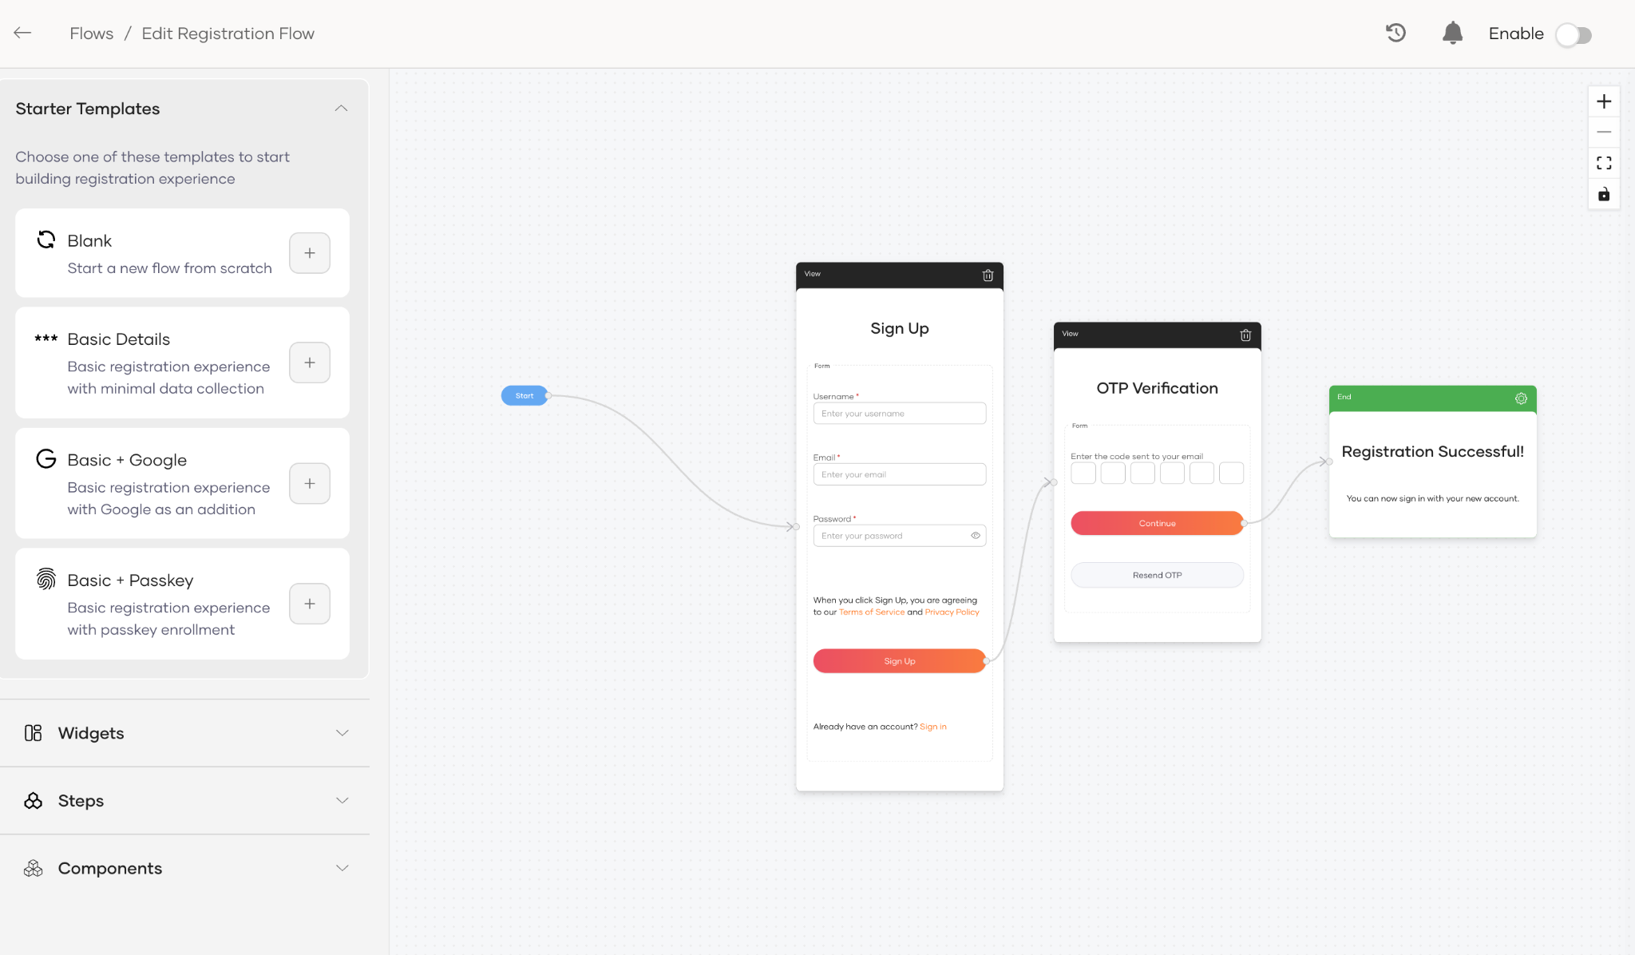
Flow builder
A visual canvas to design user identity journeys.
Provides templates, widgets, steps and components to help build your flow
Changes can be saved, tested, and published when ready.

Slide 9
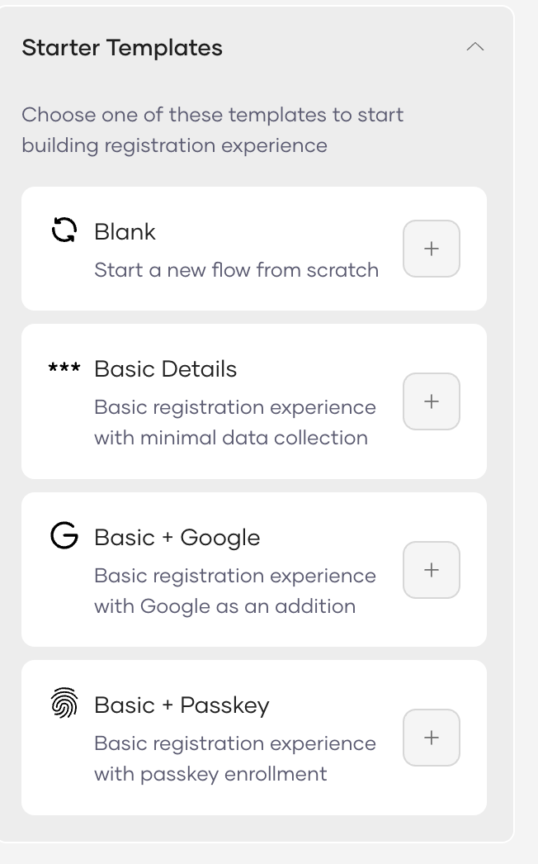
Templates
Predefined templates for common identity journeys.
Start with a ready-made structure and customize it as needed.
Modify steps, conditions, and validations.
Or start from a blank canvas for full control.

Slide 10
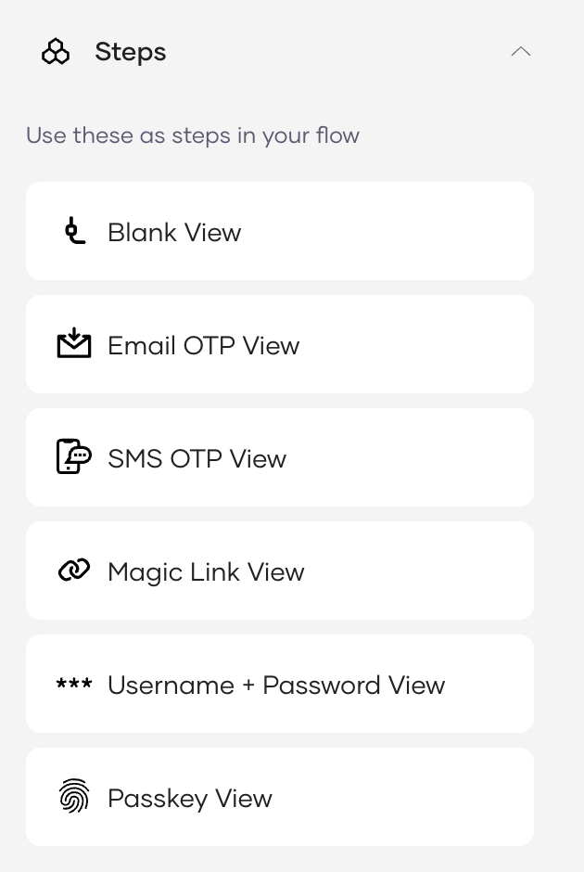
Steps
A self-contained authentication stage within a flow.
A flow can include multiple steps.
A step can contain one or multiple authentication methods.
Users must complete a step before proceeding to the next step.

Slide 11
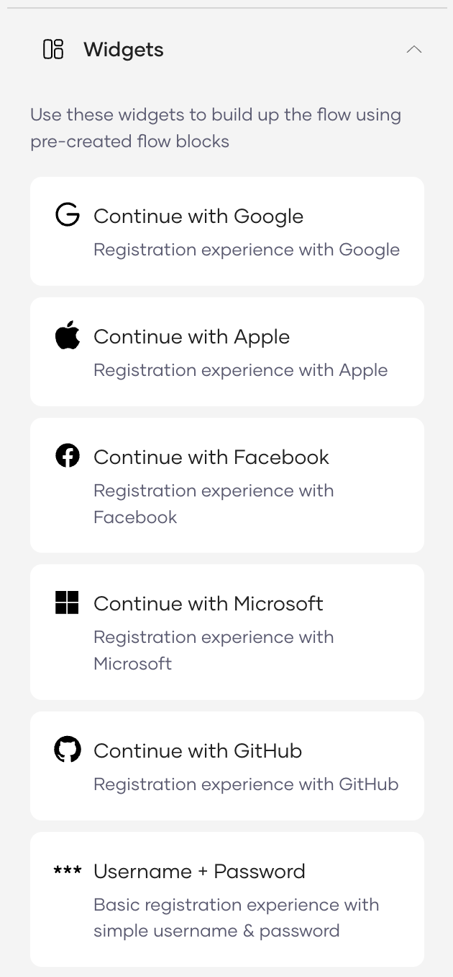
Widgets
Predefined authentication block that can be added to a step.
Each block represents a way for users to prove their identity.
Drag and drop widgets into a step.
Combine multiple widgets within the same step.

Slide 12
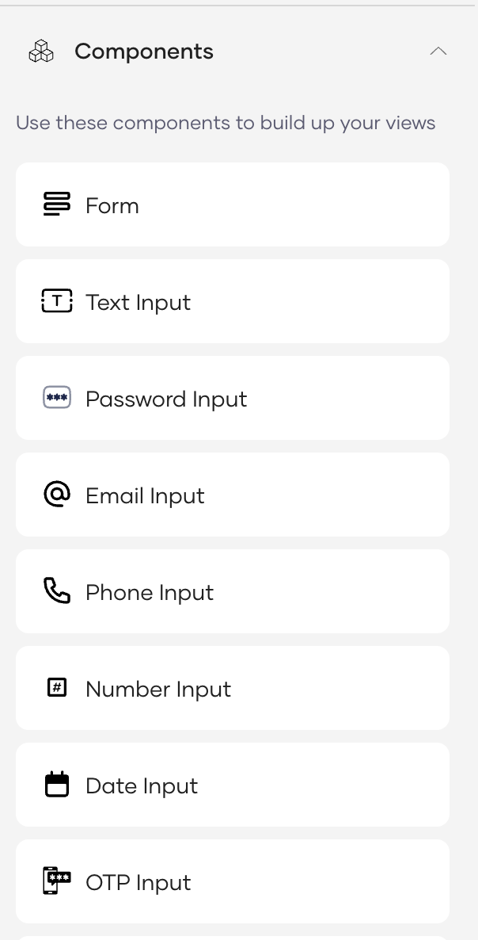
Components
Individual UI elements placed inside a step.
Used to design the user-facing interface of the flow.
Control how information is collected and displayed.

Slide 13
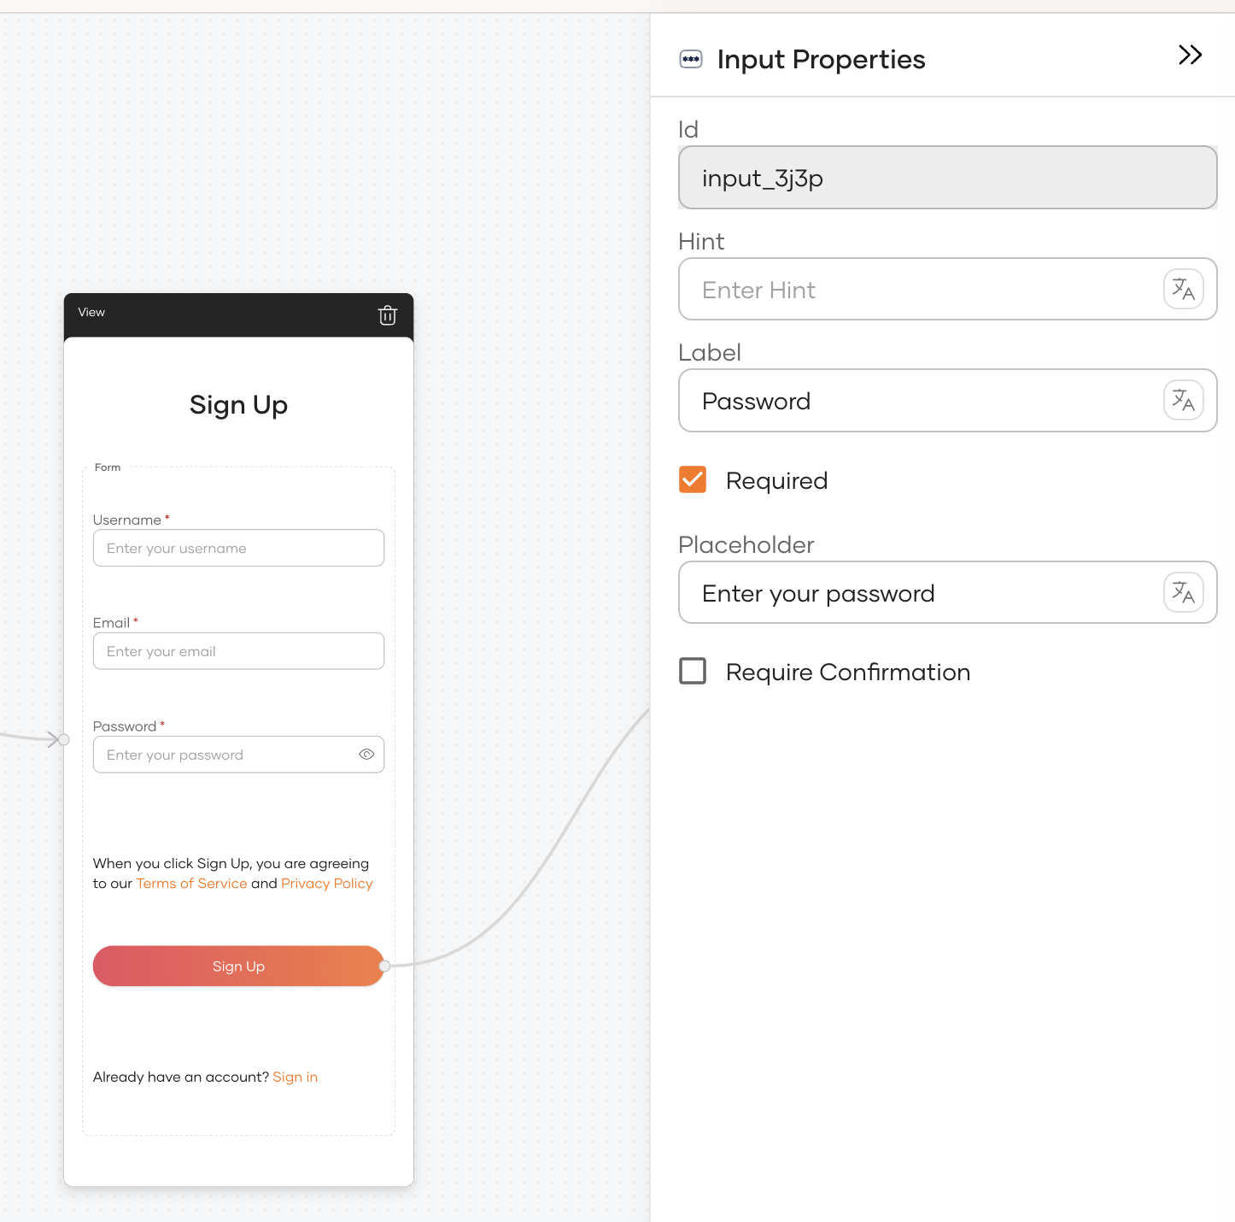
Component properties
Each component includes configurable properties.
Properties control behavior, appearance, and validation.
Fully customizable to match your flow requirements.

Slide 14
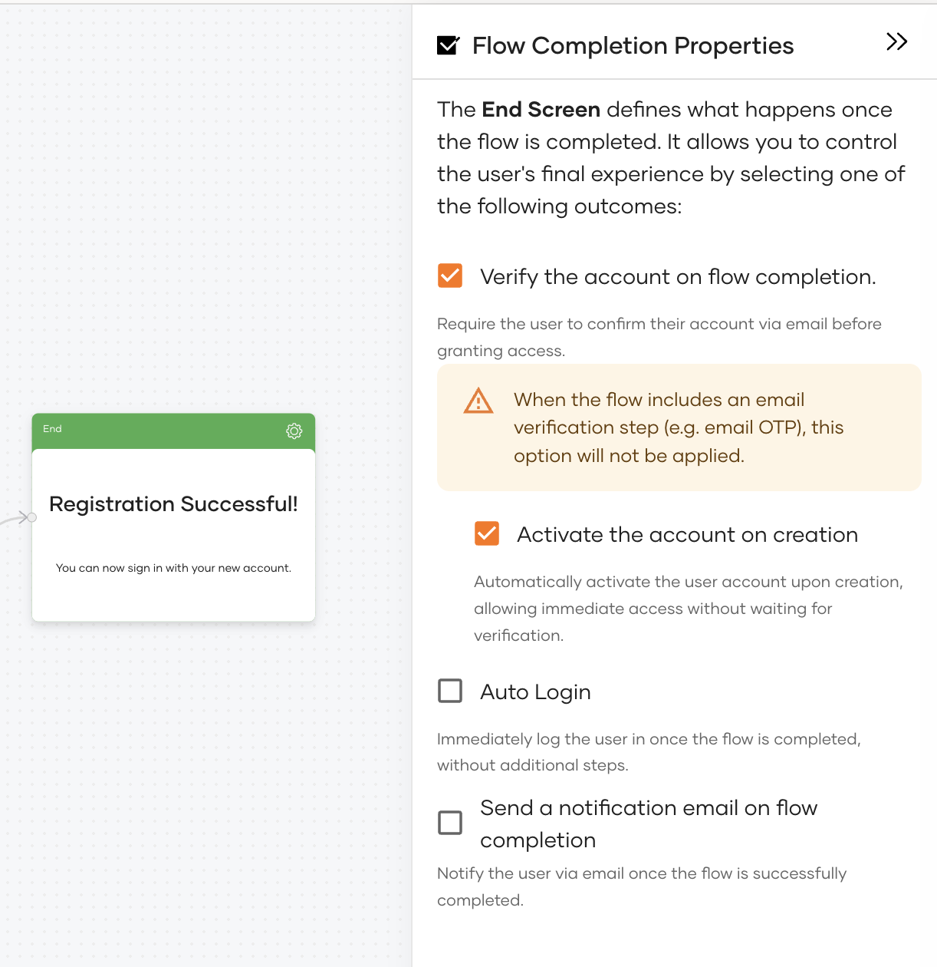
Flow completion properties
Define what happens after the user successfully completes the flow.
Control the final user experience. (e.g. auto login, activate the account, wait for verification)
Trigger post-flow actions such as sending email notifications.

Slide 15
Demo

Slide 16
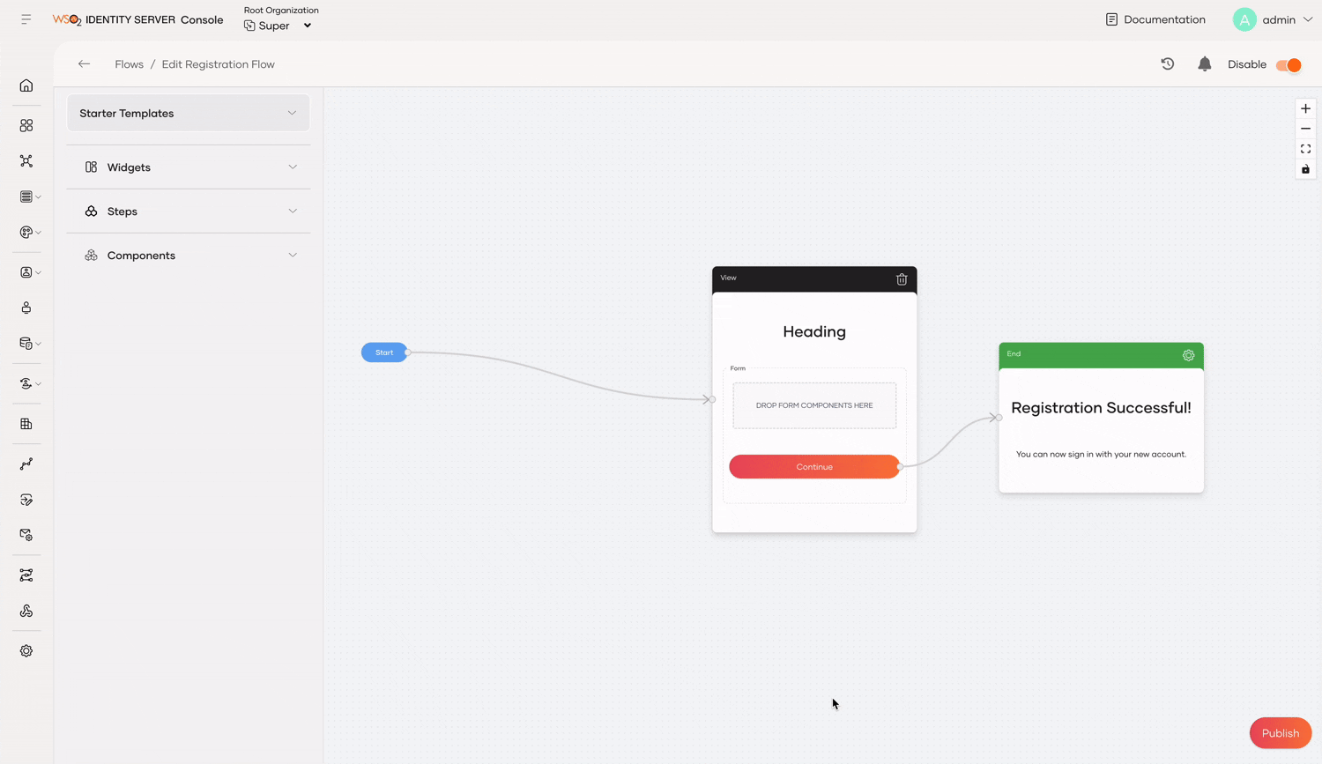
Step 1: Design the user sign in form with components

Slide 17
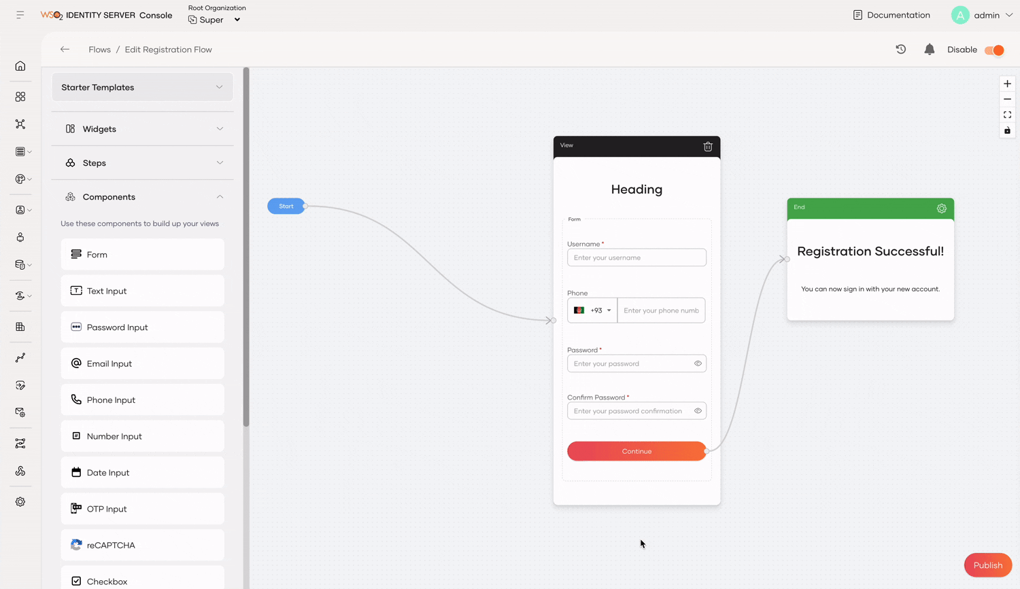
Step 2: Add the Continue with Google widget to the step

Slide 18
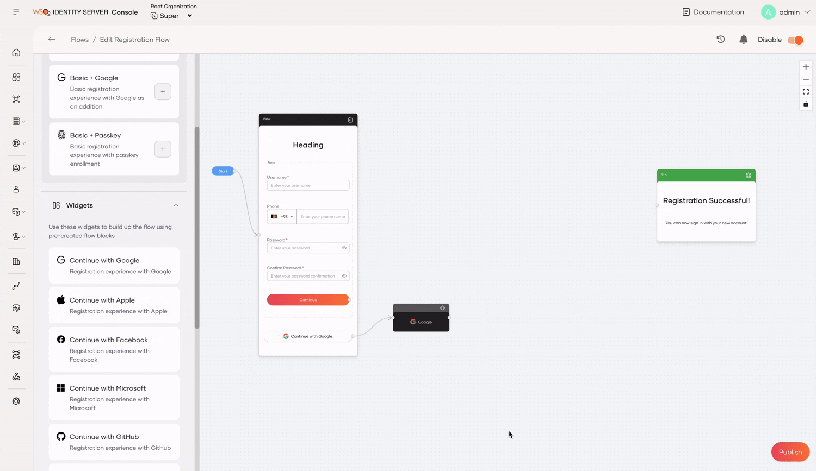
Step 3: Add a new step for SMS OTP verification

Slide 19
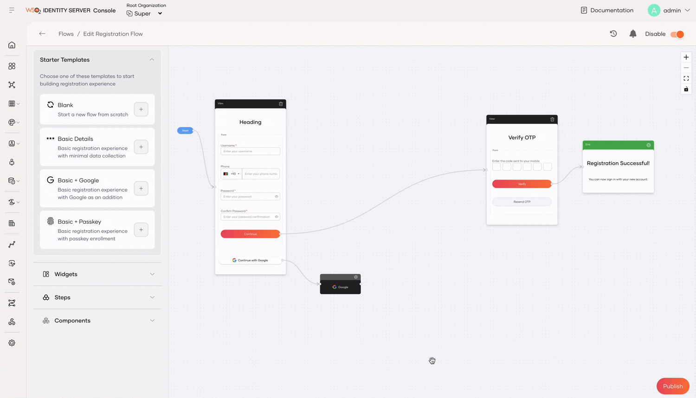
Step 4: Add a new step to request phone numbers from users signing up with Google

Slide 20
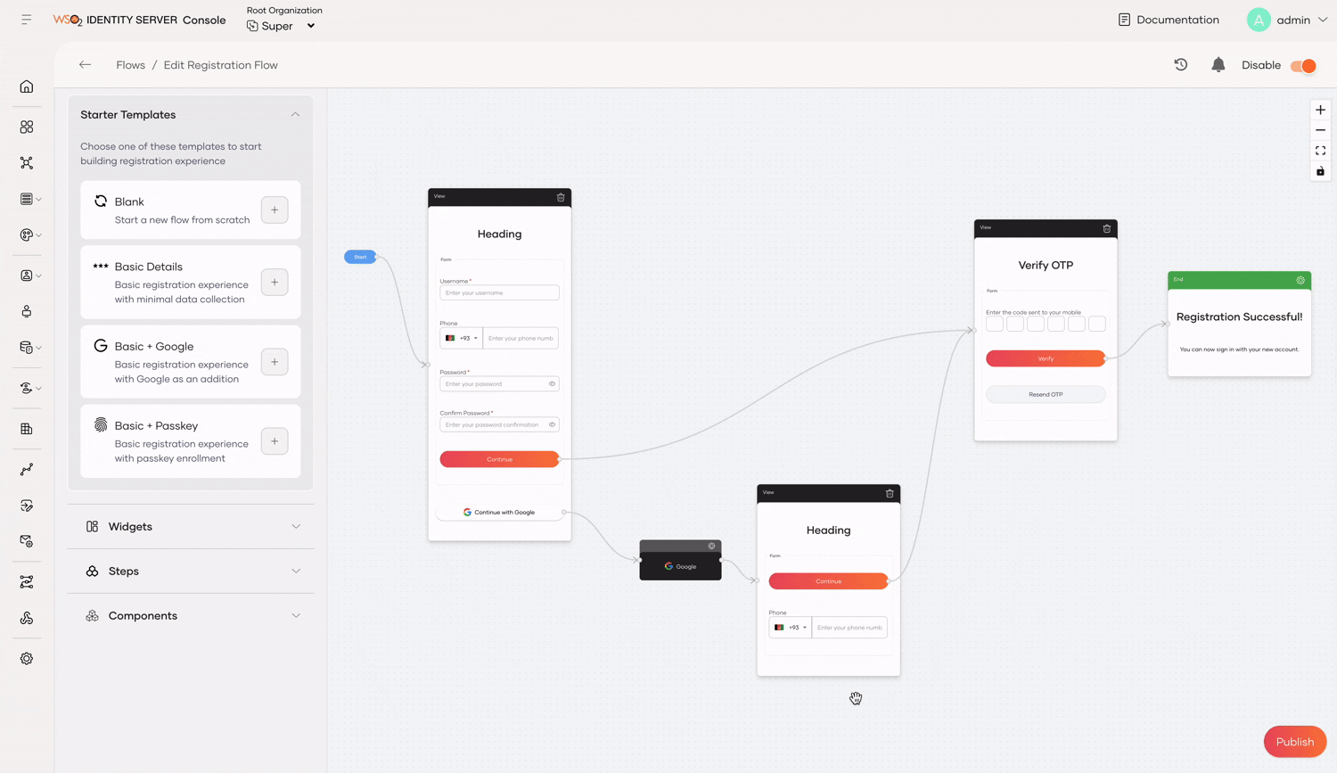
Step 5: Refine form titles and publish changes

Slide 21
Troubleshoot errors

Slide 22
Troubleshoot errors
WSO2 Identity Server automatically versions your design flow, allowing you to revert to any previous version with a single click.
Errors, warnings, and informational messages generated during flow design are displayed in a dedicated tab for easy access and troubleshooting.

Slide 23
Quick Recap

Slide 24

The limitations of static identity journeys
How Flows adapt to evolving business and security requirements
Flow elements
How to design a flow
What you learnt

Slide 25



Any Questions ?
Reach us through the following channels
iam-dev@wso2.org
https://stackoverflow.com/questions/tagged/wso2-identity-server
https://discord.com/invite/Xa5VubmThw

Slide 26
Thank you!
Notes:
Acknowledge that it’s been a lot of changes within the team
Thank you for your taking onboard the feedback and being open to change.
A lot of work , a lot of learning, sometimes feeling twice the exhaustion
But also hopefully seeing what I see, which is: better ways of working, more innovation in our approach, more business acumen, more effective reactivity , more ahead of the game. Because that’s where marketing needs to be.
All this in a context where it’s also been a lot of changes for WSO2.
And from this standpoint I wanted to remind you of what Sanjiva said about you owning the culture

